Slide 1
House sales in King County
Team member: Ritvik Reddy, Wei Du

Slide 2
Goals of the project
To predict the house price in King County.
Use Zepplin Notebook to explore dataset
To use Apache - Spark Scala MLlib(Machine Learning Library) to build the machine learning pipeline for data handling and modeling
UI

Slide 3
Data Sources
21.6k records from Kaggle dataset: https://www.kaggle.com/harlfoxem/housesalesprediction
21 columns include the sale date, bedrooms, bathrooms, sqft_living, floors.

Slide 4
Overall Design
Training Dataset -
Data Ingestion
Build pipeline
Fit/Prediction on pipeline
Calculate evaluation metrics

Slide 5
Code Walkthrough
HousePrice
Main class, call the Spark Context and initiate the other functions
Utils/ModelUtil
Read data and format data
Construct pipeline
Fit and predict the result
Utils/EvaluateUtil
Use MSE to evaluate the performance on testing data set
Calculate R-Squared value to evaluate the performance on testing data set

Slide 6
Result
MSE: 174113
Target: less than 180000
R-Squared: 0.761
Target: greater than 0.7
Running time: 24 seconds
Target: 3 seconds

Slide 7
Test Cases Implemented
The dataset should not be null
The train set should not be null
The test set should not be null
Running time should be less than 3 seconds
MSE should be less than 1800000
R-Squared should be larger than 0.7

Slide 8
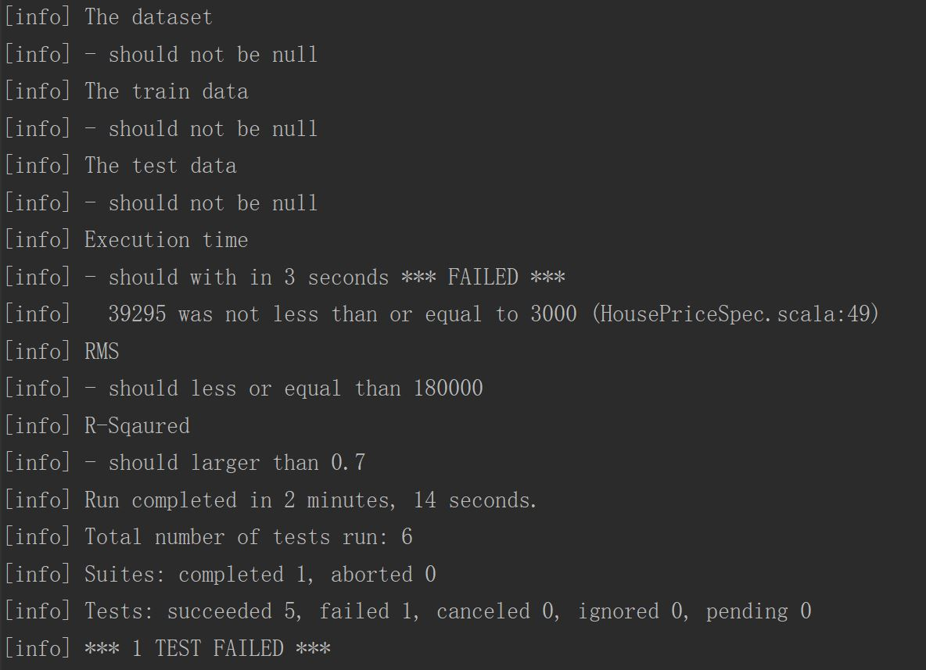
Test results

Slide 9
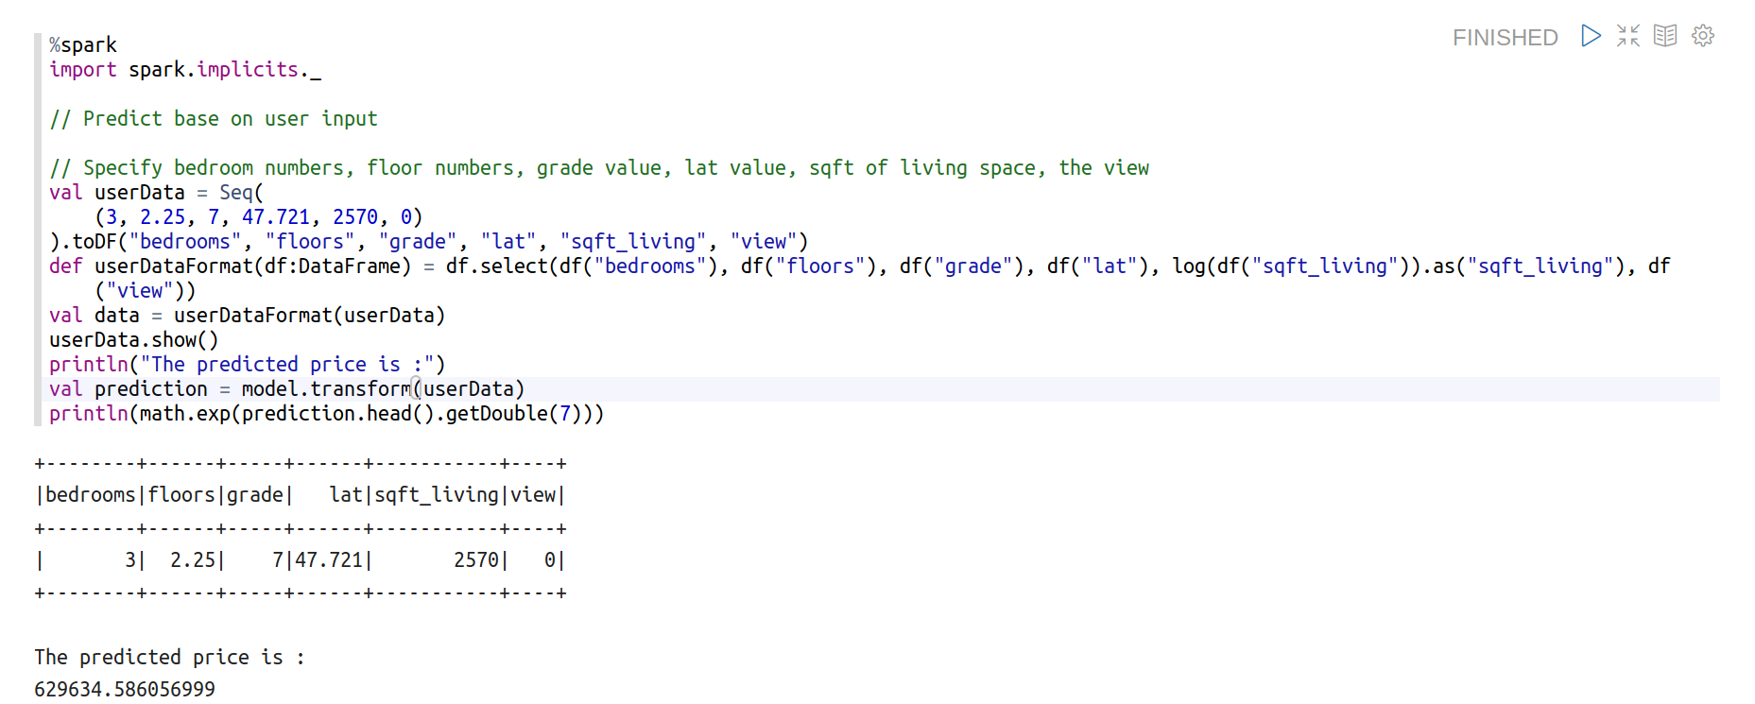
Zeppelin notebook UI

Slide 10
Conclusion
This dataset is quite complex for linear regression and the relation of k-NN is hard to observe
The log scale helps reducing the variance of sqft_living and price
The random forest tree has better performance but it takes a lot more time
The tree models are tend to overfit on training dataset, the split of training and testing is very important

